Slide 1
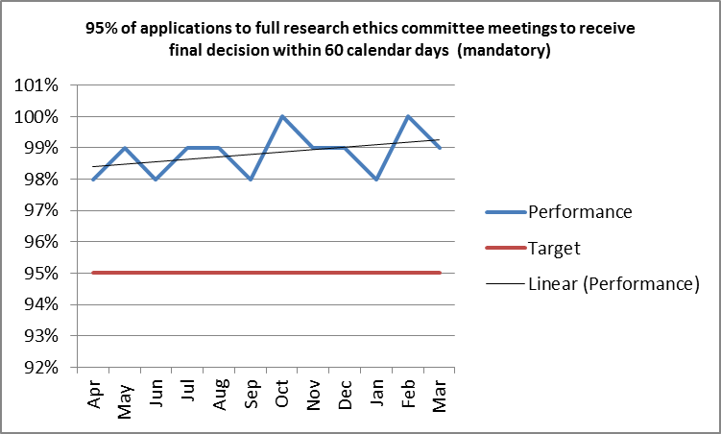
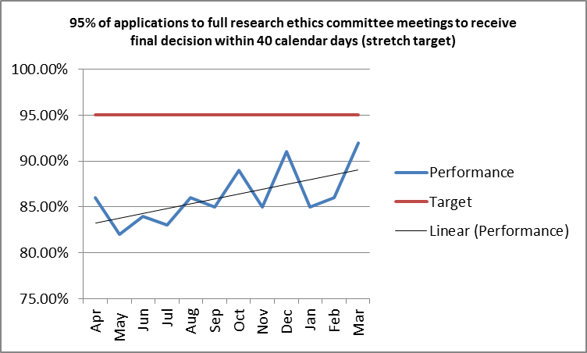
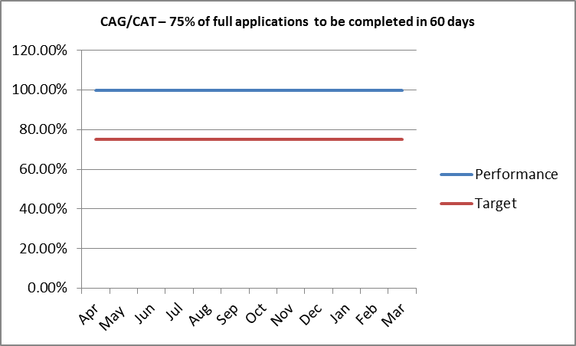
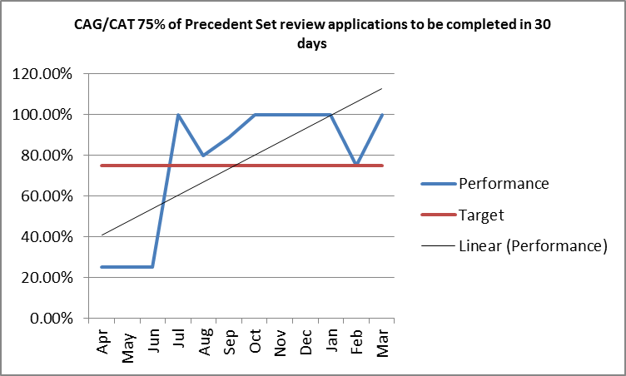
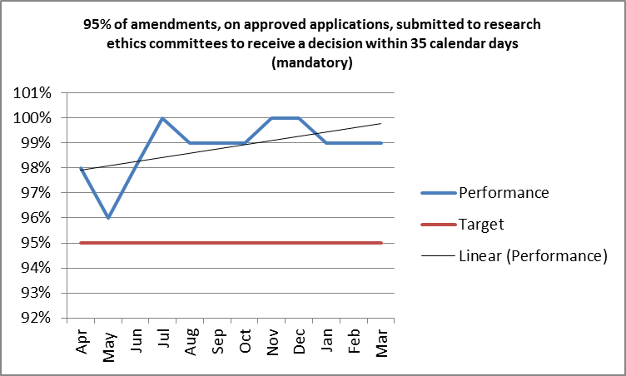
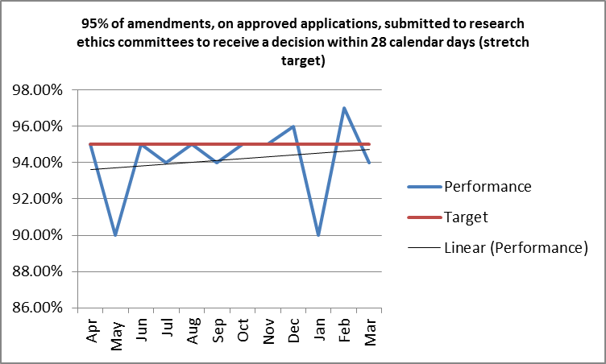
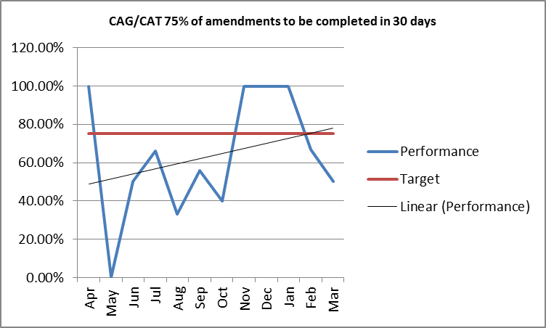
HRA KPI REPORT Q4 and Annual Summary
The content represents a summary of the main areas of 2014/15 HRA performance. It represents a snapshot view over the last 12 months and also offers (in some examples) an indication of direction of travel through use of a ‘trend line’
Please note does not cover all KPI’s included in main spreadsheet
Headlines - Operations
Trends across all operational areas reflect improving performance over the year
REC mandatory targets met or exceeded for each reporting period
Although stretch targets remain a challenge, data indicates a closing of the gap and on a number of occasions individual centres have met targets.
March 2015 performance exceptional. Stretched target very difficult to achieve but best ever performance.
Headlines – Approval
Although not represented graphically, the Approval programme remains on course to deliver indicators C1a-C1f
Trend analysis - Operations

Slide 2
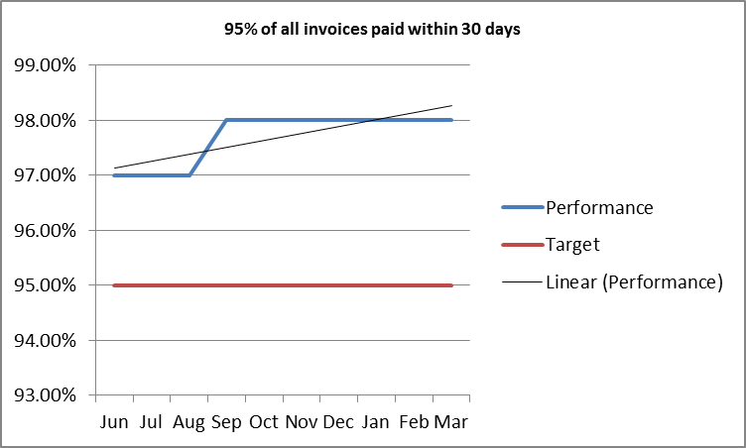
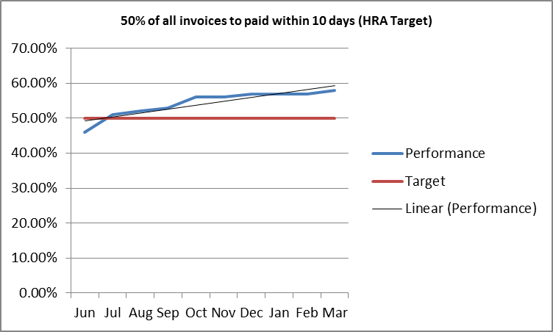
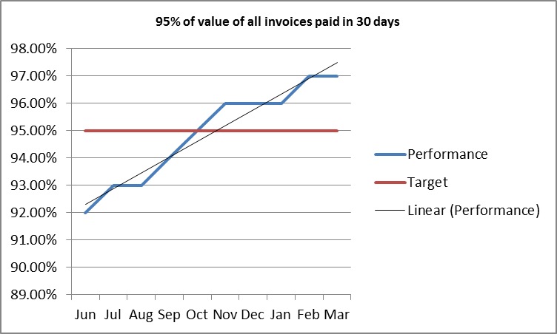
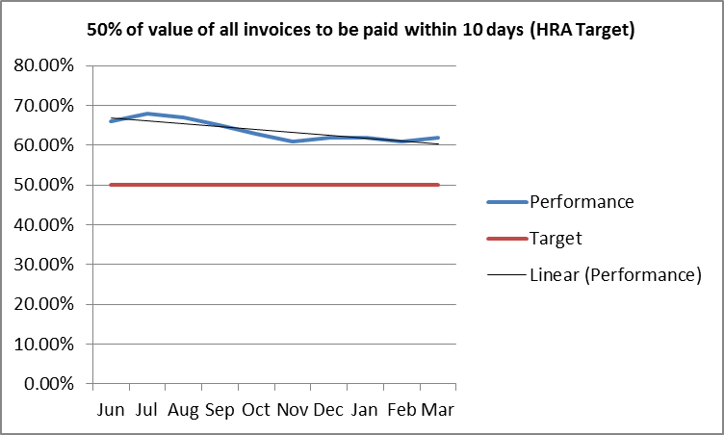
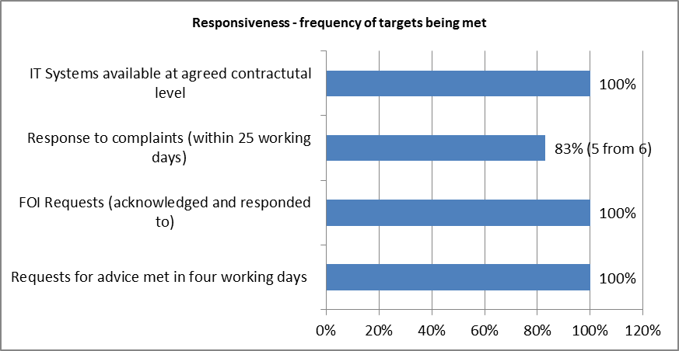
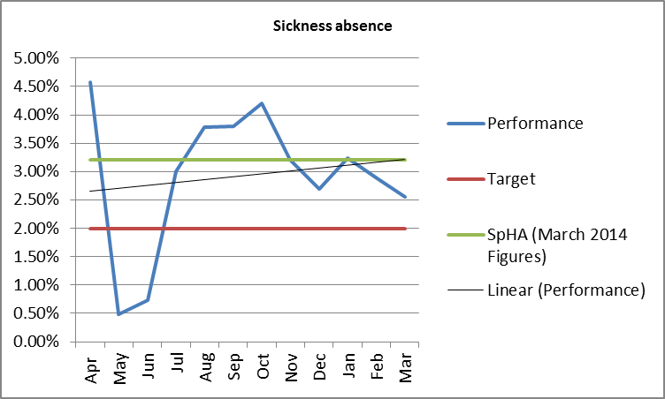
Finance – Trend Analysis
Headlines – Finance
All areas reflect improving performance over the year
The 30 day target for payment of invoices was consistently exceeded for each month
As above for the 50% of value of all invoices being paid within 10 days
By end of 2014/15 all payment targets were being met
Very strong performance particularly from a small team that have faced a number of capacity issues
Headlines – Responsiveness
Critically IRAS and HARP have maintained strong levels of availability and performance
Headlines – Sickness Absence
Although annual trend is up, last Qtr figures show a downward trajectory
The annual average is 2.93% which is above HRA Target but below avg for SpHA (3.2%)

