Slide 1
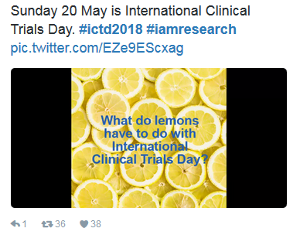
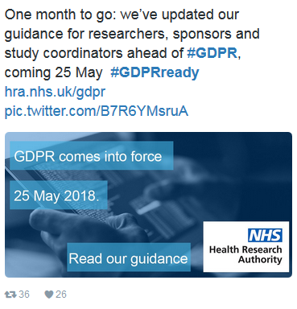
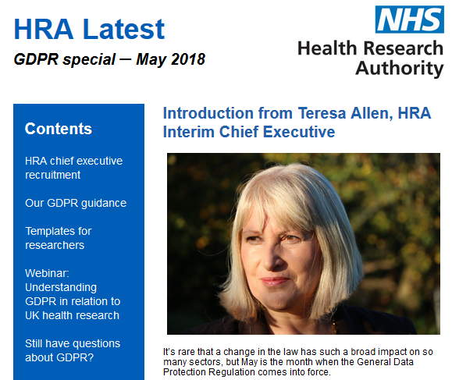
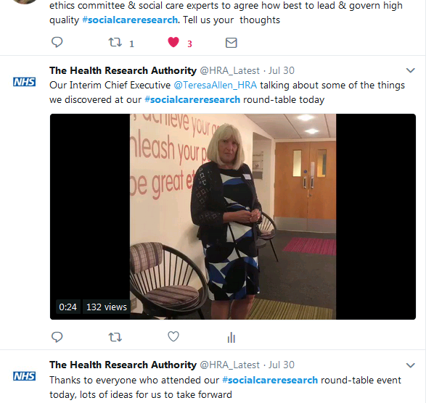
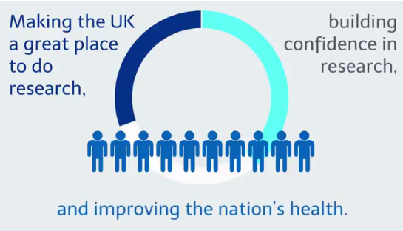
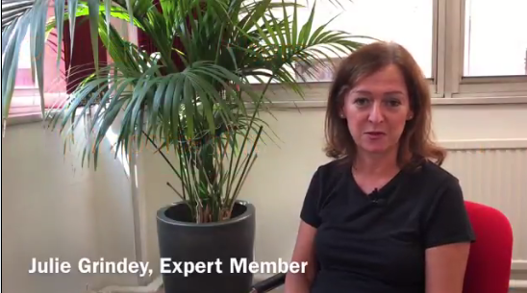
Communications impact report
HRA comms six months’ review
10 October 2018

Slide 2
Increased reach
More engaging content
Stronger evidence-led approach
18% more people
visiting hra.nhs.uk,
(year on year)
19% more people
reading the newsletter
(year on year)
17% more people
keeping up-to-date with our work via twitter
(over past 6 months)

Slide 3
hra.nhs.uk
Purpose:
The website is a key channel to keep stakeholders updated on how we’re championing health and social care research, and how we’re making it easier to conduct high-quality research.
What’s changed:
A substantial project over the past 12 months means the website is more user-focused and can better showcase engaging and dynamic content.

Slide 4
What have we seen:
The focus on what visitors to our website want has prompted high user satisfaction, and more people are using our website.
How does this inform our approach today:
We’ve been able to apply the learning from the website project to new content uploaded to the site, notably around the GDPR guidance, which was very well received.

Slide 5
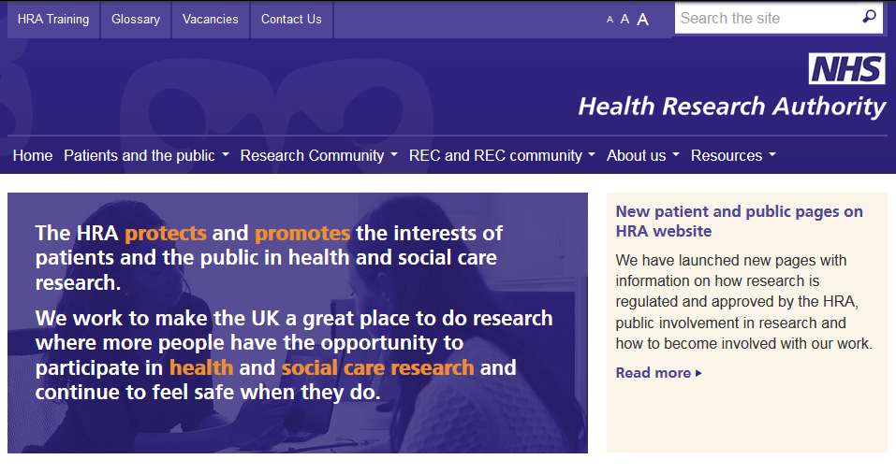
1.3 million page views already this financial year, vs 1.1 million in the same period in 2017
The news pages have been visited almost 50,000 times since April vs 12,000 times in the corresponding period in 2017.

Slide 6
Crucially, as well as attracting more people to the website, our user focused approach has meant user satisfaction is very high.
Graph shows percentage of people scoring our website 7/10 or higher:

Slide 7
What comes next?
Continued use of analytics and analysis of user feedback to drive content and development of website
Preparation to ensure site complies with new accessibility requirements coming in 2020.

Slide 8
HRA Latest
Purpose:
The newsletter directly addresses stakeholders, showing how we’re championing health and social care research, and updating researchers where we’ve made changes to make it easier to conduct high-quality research.
What’s changed:
Shift from quarterly to monthly, to reflect demand and increased number of time sensitive stories. Shorter stories with links to drive traffic to website.

Slide 9
What have we seen:
Number of subscribers continues to grow (up to almost 4,000 stakeholders), with a steady open rate despite the increased frequency.
How does this inform our approach today:
By monitoring which stories people click to read more about, we’ve been able to identify key topics of interest, prompting a GDPR special. Noting that frequency of the newsletter doesn’t diminish demand meant we were comfortable putting out an additional email when Teresa’s appointment was confirmed.

Slide 10
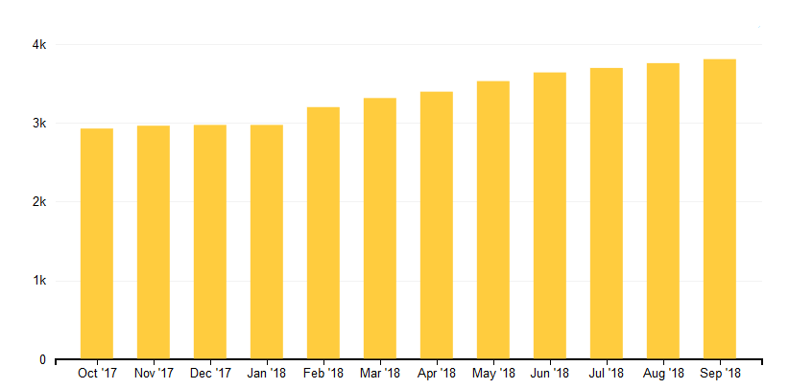
Result is greater number subscribers, which the graph shows is steadily rising
In Nov 2016, 725 read the newsletter, vs 1,270 people reading it in May 2018

Slide 11
What comes next?
Continued analysis of open rate to confirm monthly newsletter approach.
Promotion of newsletter as source of regular up-to-date information on HRA’s work.

Slide 12
Twitter @HRA_Latest
Purpose:
Twitter is an effective channel for engaging people in how we’re championing research, and also allows us to demonstrate how that work fits into the bigger picture of making the UK an attractive place to carry out research.
What’s changed:
Over the past year we’ve focused on growing our followers, by posting more frequently, collaborating with others and creating more engaging content.

Slide 13
What have we seen:
A growing number of followers means more people engaged in our work and aware of how we fit into the broader NHS picture, supporting our strategic ambitions.
How does this inform our approach today:
Twitter is now an effective channel for us to communicate with stakeholders. Analytics allow us to identify and repeat successful approaches, for instance using animations and leveraging support from other organisations to reach broader stakeholder groups.

Slide 14
Over the past year we’ve focused on growing our followers, posting more frequently and producing engaging content
As a result, we’re growing an audience engaged in the HRA’s work. The graphs show audience growth year on year, and across the past six months:

Slide 15
Case study one:
Contributing to making the UK an attractive place to do research
Dynamic, shareable content
Working alongside NHS partners
8,000 people read about how the HRA fits in the broader NHS picture

Slide 16
Case study two:
Live tweeting to support an emerging area
Used video to extend reach of workshop beyond the room
Engaged with partner to reach an audience potentially unaware of our work

Slide 17
Social media is a platform where creating original content is crucial to maintain and grow engagement. We’re developing new skills so that we can produce engaging content in house, notably around videos and animations. These have had significant impact, maximising the impact of our limited resources.

Slide 18
What comes next?
Continue to grow number of followers.
Further work to develop our social care research following
Development of an organisational comms strategy to include a new personal social media policy

Slide 19
Media enquiries
Purpose:
Media coverage can have an enormous impact on our reputation, particularly given the sensitive area we operate in.

Slide 20
What have we seen:
Ten responses to media enquiries provided so far this year, inc to Telegraph, BBC and BMJ. Prepared responses for potential interest in high profile stories, inc the academic paper published to challenge the results of the PACE trial, and the recent Select Committee report.
How does this inform our approach today:
24/7 media service offered. We continue to develop lines for high profile areas, to protect the reputation of the HRA if needed. This work can be resource intensive, often at short notice.

Slide 21
Internal comms
Purpose:
Effectively communicating with staff is crucial to staff engagement, and to ensure the HRA is effective and efficient
What’s changed:
Over the past two years, we’ve focused on ensuring our internal communications better reflect the organisation, and are presented with staff in mind

Slide 22
Examples of better presenting internal communications include:
Use of blogs
Focus on people
Including voices from across the HRA
Improved all staff VC

Slide 23
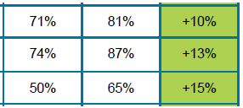
What have we seen:
The staff survey shows this has been successful. Three key stats were in the six most improved indicators:
How does this inform our approach today:
Comms support has continued around key topics, eg workforce change and IT response to staff survey criticism. But challenges remain: HRA News evaluation, intranet under-used

Slide 24
What comes next?
Review of internal comms, including recognising staff effort and achievement, and the re-procurement of our intranet host

Slide 25
KPIs for 2018
Unique page views to the news pages on our website
Q1: 23,442 (Note: Q1 fig inflated by significant GDPR interest)
Q2: 17,898
User satisfaction with website from researchers (% rating their experience as 7/10 or higher)
Q1: Apr – 67%; May – 66%; Jun – 89%;
Q2: Jul – 89%; Aug – 72%; Sep – 76%;

Slide 26
KPIs for 2018
Number of subscribers opening HRA Latest newsletter
Q1: 2,330 (Note: no newsletter in Apr)
Q2: 3,218
Number of twitter followers
End of Q1: 2,831
End of Q2: 3,140
Note: Additional KPI regarding internal communication to be confirmed for Q3.

